Slide 1


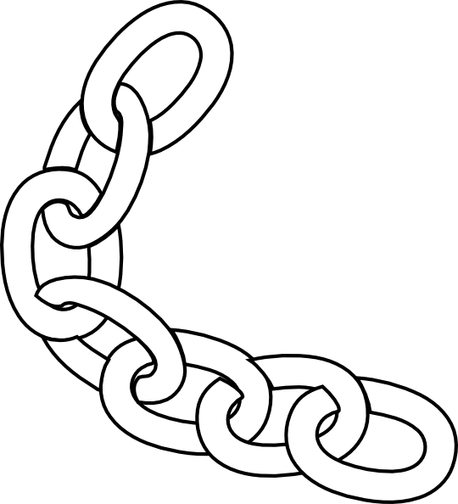

 | Corn Pop and the Bad Boys Course Designer: Kris Erickson (Inspired by the real life events of Joseph Biden Jr.) |  |  |  |  | Bay 5
Corn Pop was a bad dude, and he ran a bunch of bad boys. He wouldn't listen and wear his bathing cap. I said, "Hey, Esther, you! You get off that board, or I'll drag you off!” He came off and he said, "I'll be waiting for you!" There were three guys with rusty straight razors. --Not a joke-- There's a guy named Bill Wright-Mouse, the only white guy, and he did ALL the pools. He was the mechanic. He cut off a six foot length of chain and he said, "you walk out with that chain, and you say, 'you may cut me man, but I'm gonna wrap this chain around your head.’" I was smart. Then. – Joe Biden, September 15, 2019.
START POSITION: Standing at P1 with chain held in strong hand. Weak hand naturally at side. Pistol loaded to division capacity and holstered. PCC START: Standing at P1, rifle held in weak hand at low ready, chain held in strong hand. |  | STRINGS | CONCEALMENT |  | SCORING |  | TOTAL ROUNDS
 |  | 1 | REQUIRED |  | UNLIMITED |  | 12
 |  | TARGETS |  | 4 threat.
 |  | SCORED HITS |  | Best 3 per target.
STAGE PROCEDURE: Throw Bill’s stupid chain at Corn Pop to free your gun hand and take care of business like a real (wo)man. Engage targets in tactical priority. (Shoot T1, then T2 and T3 (any order), finally shoot T4.
 |  | NOTES: Failure to throw chain will NOT result in a PE. T1 should be taller than normal to slightly obscure the two behind it, making the shooter move to one side to have a clear shot at the remaining targets.
T4
T3 & T4
T1
P1
https://www.youtube.com/watch?v=r4NmtSrqtvI

